Slide 1

ILS
Integrated Labour System
Module 2: ILS Client Information
Training Program

Slide 2
In this module, we will explore
The different types of Client Information that exist within ILS
How to search for, view, and manage existing Client Information files (including editing content and creating associations)
How to create new Client Information files, and
How to activate, deactivate, and delete Client Information files

Slide 3
Objectives
The purpose of this module is to provide a basic overview of how to find, manage, and work with the Client Information contained in the ILS system.

Slide 4
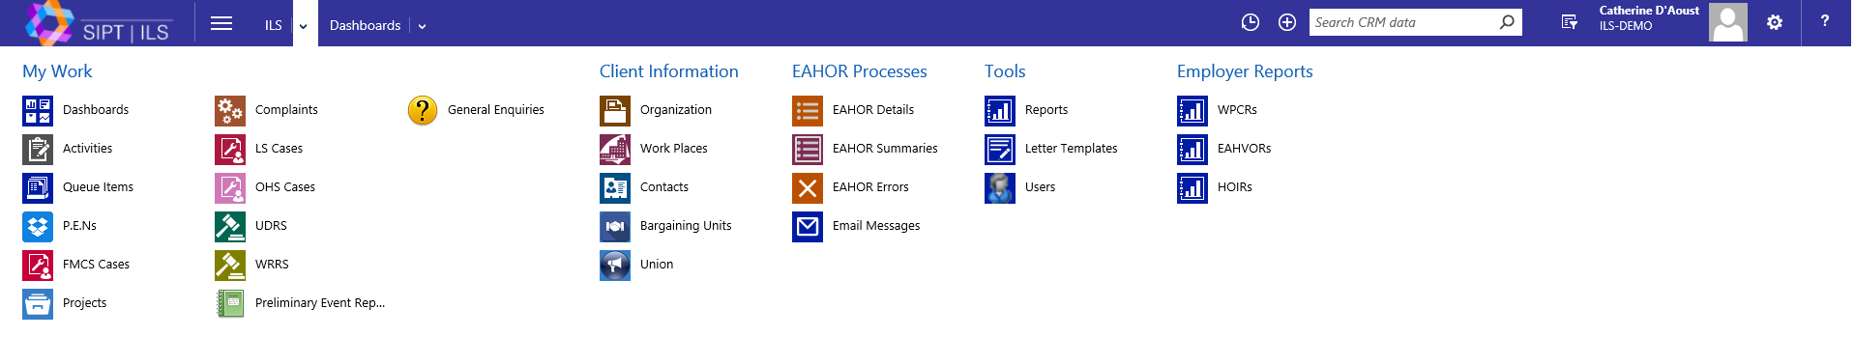
ILS Client Information
As well as being an effective case-management tool, ILS also houses the complete centralised client information book for all entities associated with the work done by the Labour Program.
The Client information - listed under the ILS Menu - is broken down into five different categories: Organizations, Work Places, Contacts, Bargaining Units, and Unions. In this module, we will focus on Organizations, Work Places and Contacts.

Slide 5
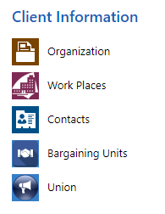
Client Information
The different categories of Client Information can be described as follows:
An Organization is an entity operating in an industry that is regulated under the jurisdiction of Canada Labour Code (ex: Air Canada).
For this module, we will only explore Organizations, Work Places and Contacts
A Work Place relates to a physical location (ex: Ottawa Airport).
A Contact refers to an individual who has been designated as the contact person associated to a specific case, investigation, general inquiry, etc. (ex: Fatiha the pilot)
A Bargaining Unit are the bargaining units associated with a Union
A Union refers to an association responsible for advancing the interests of the workers it represents (ex: CPA – the Air Canada Pilots Association

Slide 6
Command Toolbars
You will notice a command toolbar is often found at the top of the screen. The options in this toolbar will change depending on what is highlighted or displayed on the current page. Actions that are unique to particular business will be explored in their appropriate modules.
The List command toolbar displays all of the of actions that can be taken with a given list.
The Selected Item(s) command toolbar displays all of the of actions that can be taken with items selected in a given list.
The Content command toolbar displays all of the of actions that can be taken within the content of a given item.

Slide 7
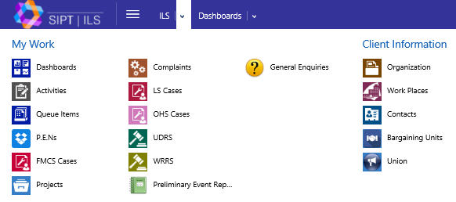
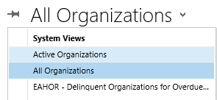
Organizations
In Module 1, we explored some of the basic ways to navigate the ILS system, including searching for content (which will be examined more fully in Module 3 – Search Features).
Let's begin by focussing our attention on exploring existing Client Information.
Using the ILS Main Menu, let's select Organization from the list of options under Client Information.
Next, select Active Organizations from the All Organization drop-down list.

Slide 8
List Command Toolbar Buttons
Once you have selected Active Organizations, you will find the List command toolbar near the top of the window. Here is a brief overview of their functions.
Delete
Does not actually work in this view
Email A Link
E-mails a link to the current list
Excel Templates
Quickly generates Excel document or creates a new template
Chart Pane
Allows you to select the location of the chart pane (top, right or off)
New
Create new contact record under this cateory
Run A Report
Runs a report on all listed records
Export to Excel
Exports current list to a static or dynamic Excel spreadsheet or to a PivotTable

Slide 9
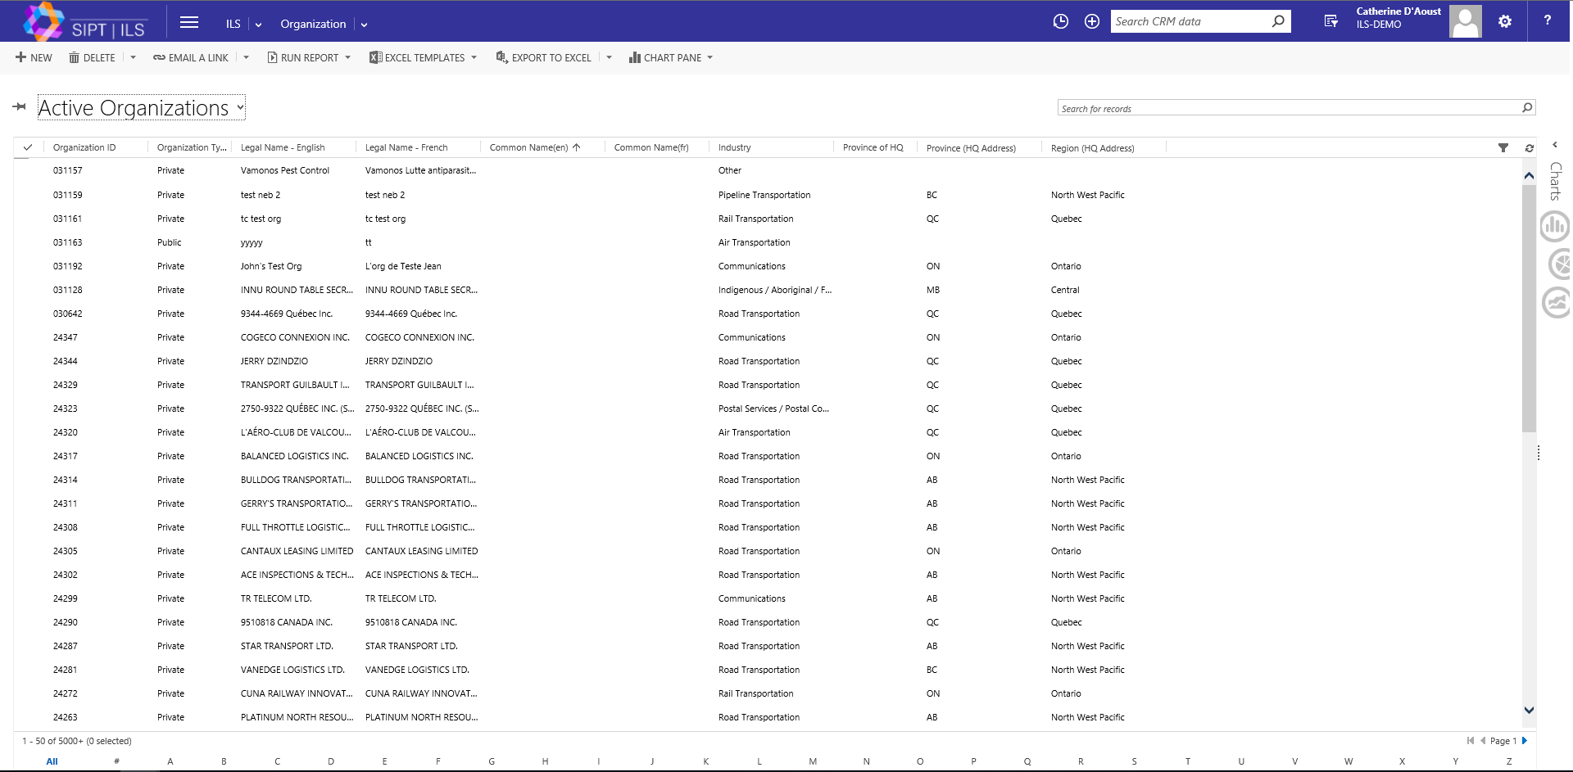
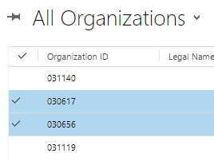
List Display - Overview
From the displayed list of Active Organizations, you can access the content of an item, or highlight one or several items by activating the checkbox in the first column.
List of Active Organizations
Checkboxes can be activated

Slide 10
Selected Item Command Toolbar
This is the command toolbar that will appear when one or several items in a list are highlighted with a checkbox.
New
Create new contact record under this category
Activate
Activates the checked contact(s)
More Commands
To be explored in Modules where they become pertinent.
Merge
Merges checked items.
Edit
Allows you to edit content fields in of checked items*.
Deactivate
Deactivates the checked contact(s)
Delete
Deletes checked items.
Send Direct Email
Emails selected items
*Note that if the Edit action is used while multiple items in the list are checked, the content changes will apply to all selected items.

Slide 11

Content Command Toolbar
When you access the content of an organization, a command toolbar will appear at the top. Here is a breakdown of the more frequently used options, some of which will be explored more closely as they become relevant.
Run Report
One of ILS's best features.
Allows you to create a report from the system.
Deactivate
Deactivate current organization file
Email A Link
E-mails a link to the current file
Connect
Create role-based connections with other Organizations
Share Edit access and permissions to current file
Relationship
Allows you to associate the current file with another record
New
Create new Organization

Slide 12
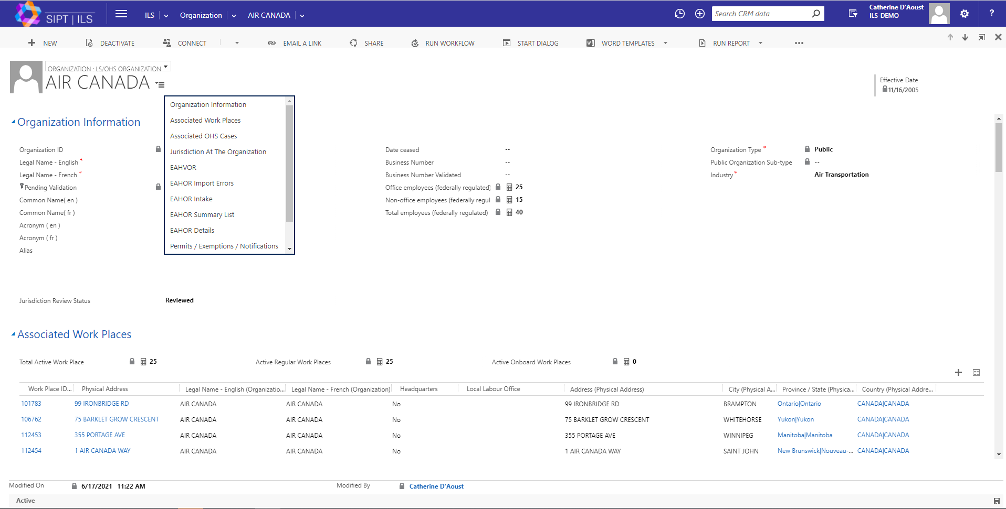
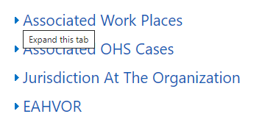
Organization Content - Sections
Once you access an organization, you will see that the information is broken down into sections that can be viewed by scrolling down the page, or by selecting a section title from the Form Sections drop-down menu, located to the right of the page title.
Sections can be hidden or revealed by activating the Expand/Collapse Tab located to the left of each section title.
Forms Sections drop-down list
In the following slides, we will explore some of the different sections.
Expand/Collapse Section Tab

Slide 13
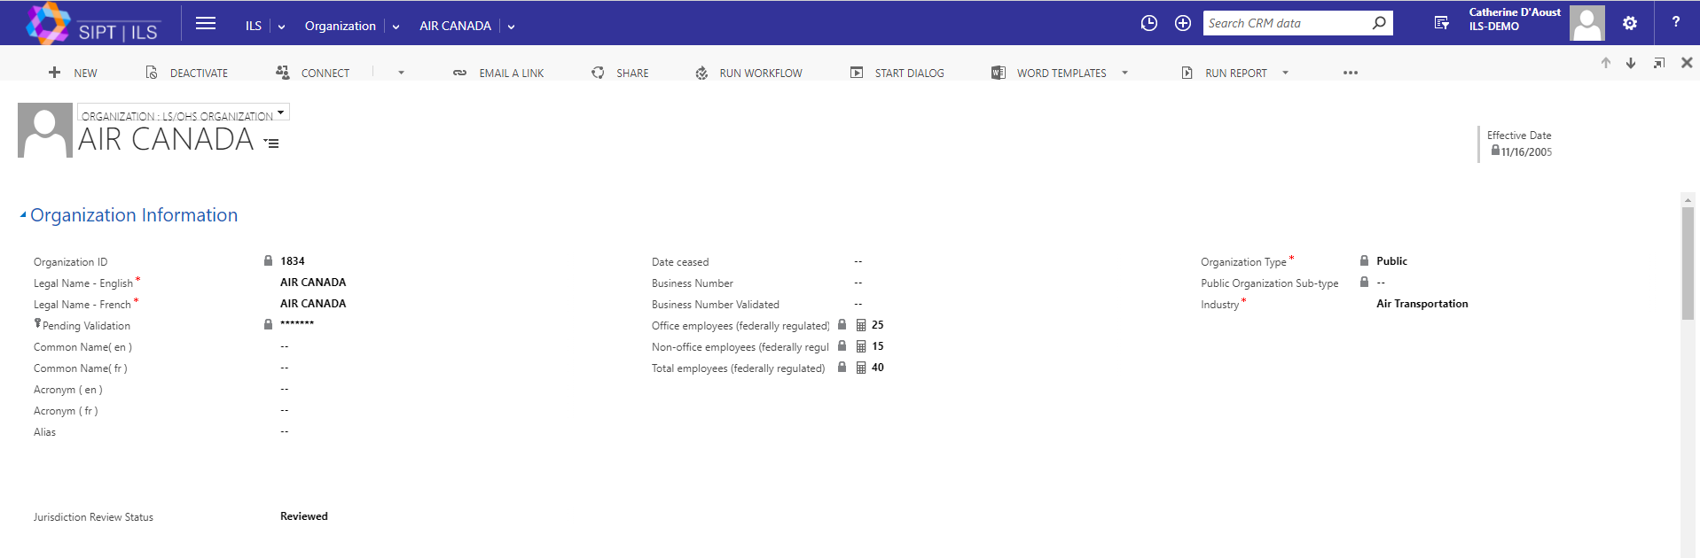
Organization Content – Sections (cont.)
The Organization Information section contains the primary information about the organization itself, such as the name, ID number, Industry type, etc.

Slide 14
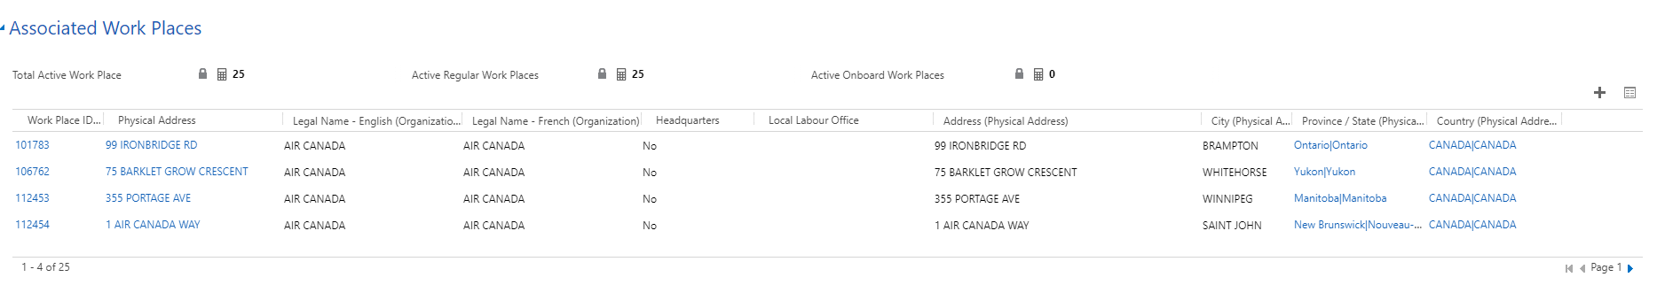
Organization Content – Sections (cont.)
The Associated Work Places section displays information related to all the work places associated with this organization. We will address Viewing a Work Place a little later in this module. Here are some of the features.
Creates new Work Place record
Number of Work Places associated with this organization
Launches view of records associated with this section

Slide 15
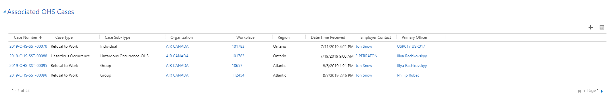
Organization Content – Sections (cont.)
The Associated [OHS] Cases tab provides an overview of all the [OHS] Cases associated with this organization. We will explore OHS Cases in detail in Module 10.
Notice again that the Add New and List Associated buttons are present.
Launches view of records associated with this section
Adds new [OHS] case record

Slide 16
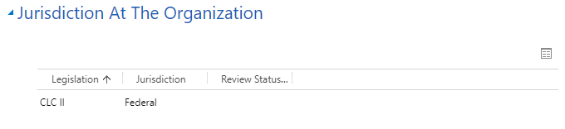
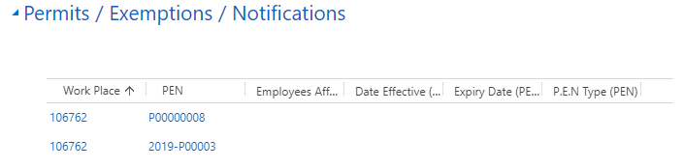
Organization Content – Sections (cont.)
The Permits/ Exemptions/ Notifications section will display all associated P.E.Ns, and the Jurisdiction section will display the jurisdictions associated with the organization.
Notice that while the Jurisdiction section has the option to view the associated records, you can not add an association.
Has associated view but no ability to add item
Neither action can be preformed in the Permits/ Exemptions/ Notifications section.
Has no associated view option nor the ability to add item
(Section tabs associated with EAHVOR and EAHOR, will be covered in our reporting-associated modules.)

Slide 17
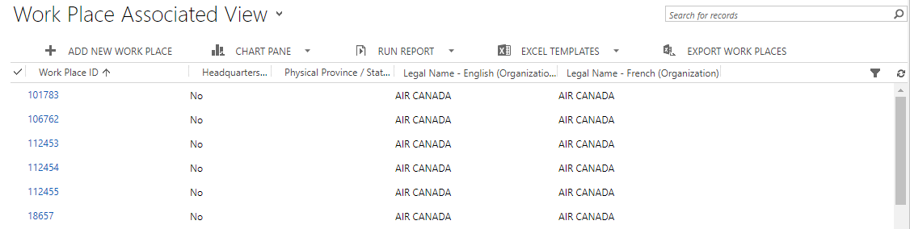
Organization Content – Sections (cont.)
As with any list, section contents can be filtered using column headers, and/or activating the filter tool.
Filter tool
Column headers

Slide 18
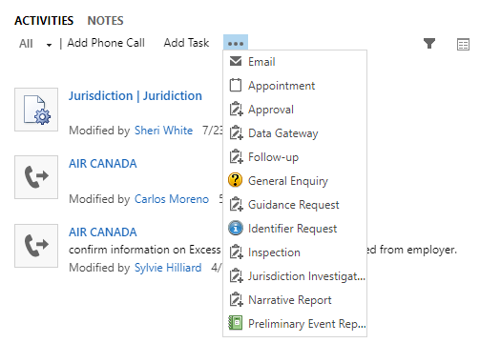
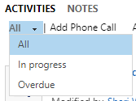
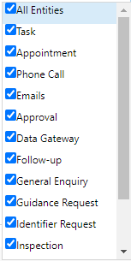
Organization Content – Sections (cont.)
There are two subsections of the Activity section. They are Activities and Notes.
Activities lets you view all activities that are associated with the Organization. If the list is long, various filters can be applied, for example by type (ex: Email) or status (i.e.: Overdue or In progress).
Additional activities
Associated records view
Status filter
Type filter
There also a variety of actions you can perform, such as documenting a phone call or adding a task. To access the drop-down list of additional actions you can take, select the ellipses next to Add Task.

Slide 19
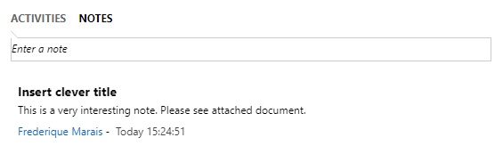
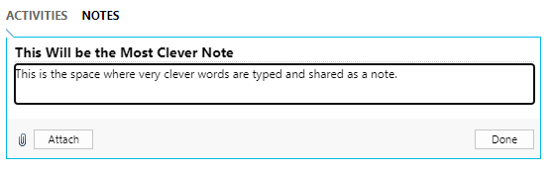

Organization Content – Sections (cont.)
Notes allows you to add a note to the Activity section. It will also display other notes that were previous created.
Select this area to begin a new note
Once you select Attach, the Choose file button will appear and you can navigate to your desired attachment
When you create a new note, you can add a title and add an attachment. Simply select the Attach button, and you will be given the option to navigate to your chosen file. To save the note, select the Done button.

Slide 20
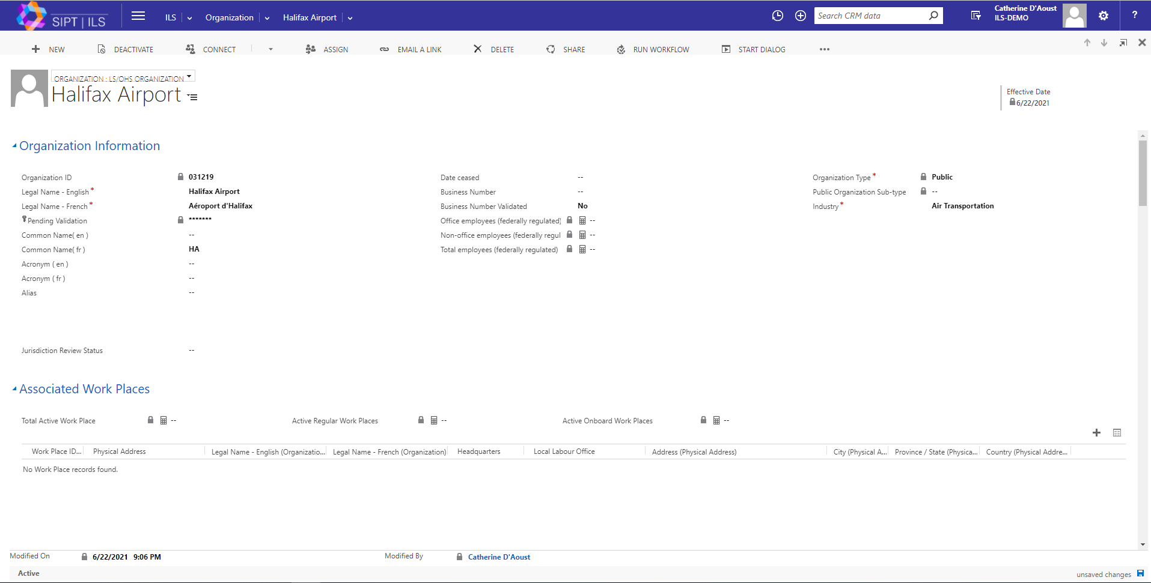
Organization Content – Saving changes
If changes are made to an organization's content, the changes will usually save automatically. You can opt to save the changes yourself by selecting the Save icon located on the bottom, right hand corner of the window.
Select the Save icon to save your changes right away.

Slide 21
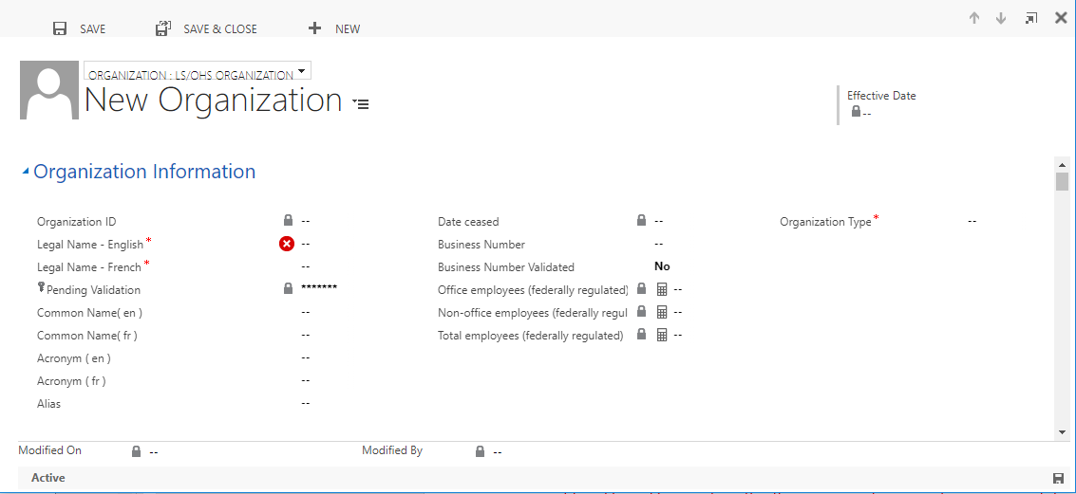
Creating a new record
When you select New from the command toolbar, a new window will launch, allowing you to create a new organization record. Fields marked with a red asterisk (*) are mandatory, and must be populated before the record can be saved to the system.
Fields marked with a red asterisk are mandatory

Slide 22
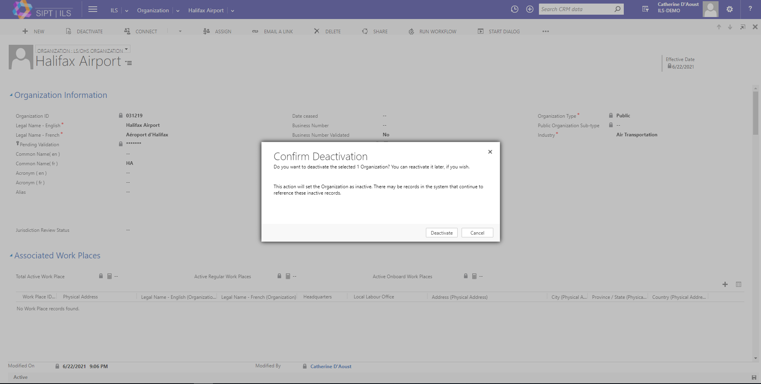
Deactivating a record
As you explore the different options on this screen, you will notice that Organization records cannot be deleted. They can, however, be deactivated.
To deactivate an Organization, select the Deactivate button from the command toolbar and confirm the deactivation in the pop-up window.

Slide 23
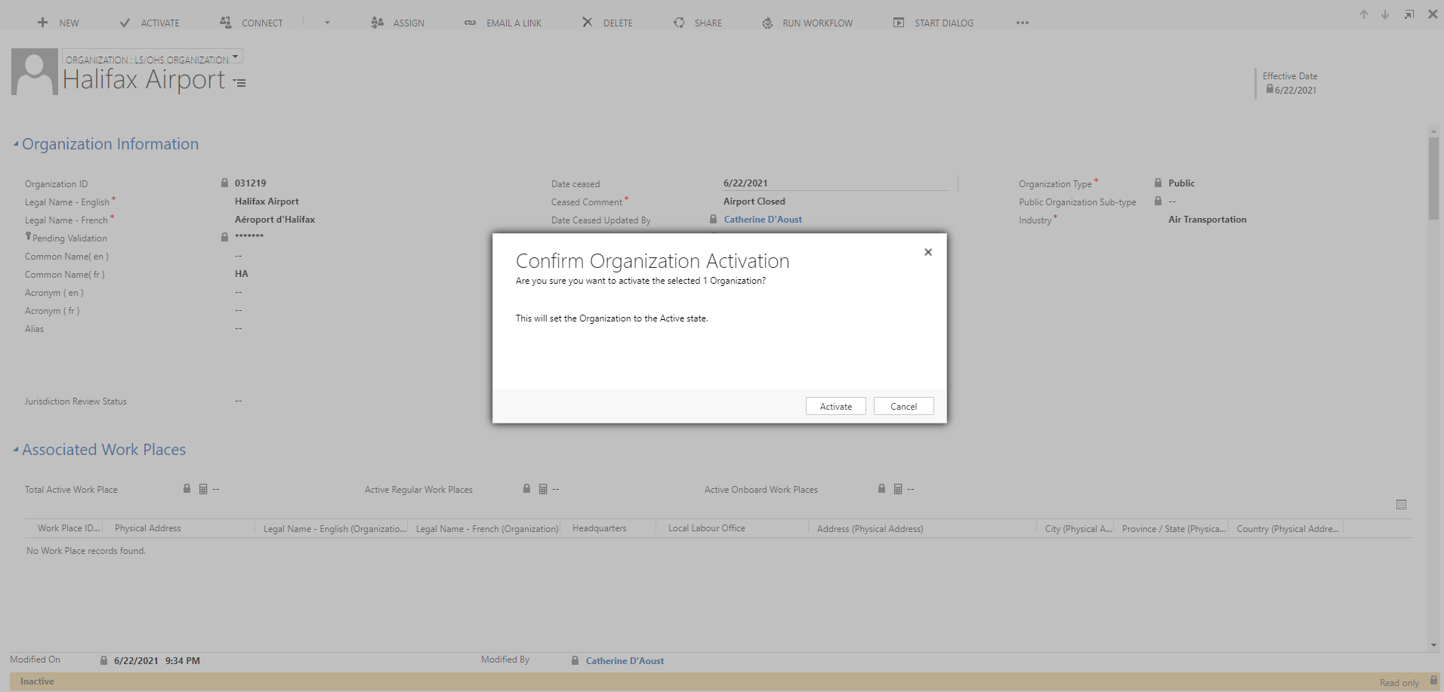
Reactivating a record
A deactivated organization will have a yellow bar along the bottom of the window.
To reactivate an organization, simply select the Activate button from the command toolbar, and confirm the activation in the pop-up window.
This action will revert the Organization status to active, restoring it as well as its records. The yellow bar will disappear.

Slide 24
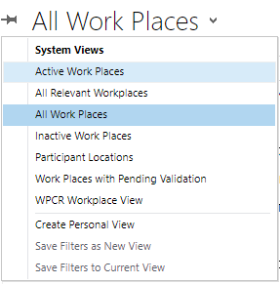
Work Places
Using the ILS Main Menu, select Work Places from the list of options under Client Information. To ensure we are only accessing Work Places that are designated as active, lets select Active Work Places from the dropdown next to All Work Places.

Slide 25
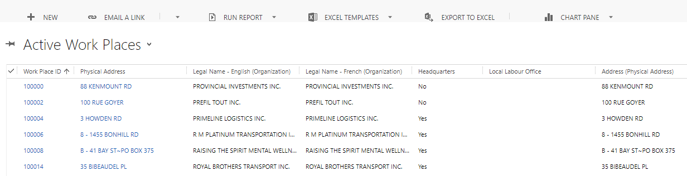
Work Places – List Command Toolbar
Now that we have adjusted out list to display only Active Work Places, lets draw our attention to the command toolbar which, as you will notice, provides the same options as those listed under Organizations.

Slide 26
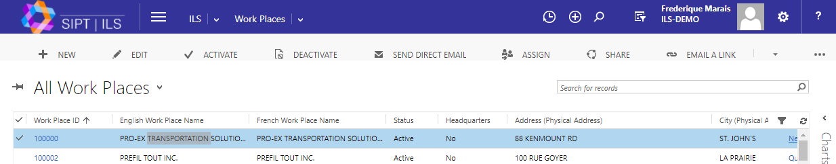
Work Places - Selected Items Command Toolbar
While many of the essential command toolbar buttons were discussed under Organizations, there are a few others that require attention.
The Assign button allows you to assign the item to someone else’s queue, meaning, the owner of the record will change to whomever you assign it to.
By contrast, the Share buttons allows you to share the contact with someone else.

Slide 27
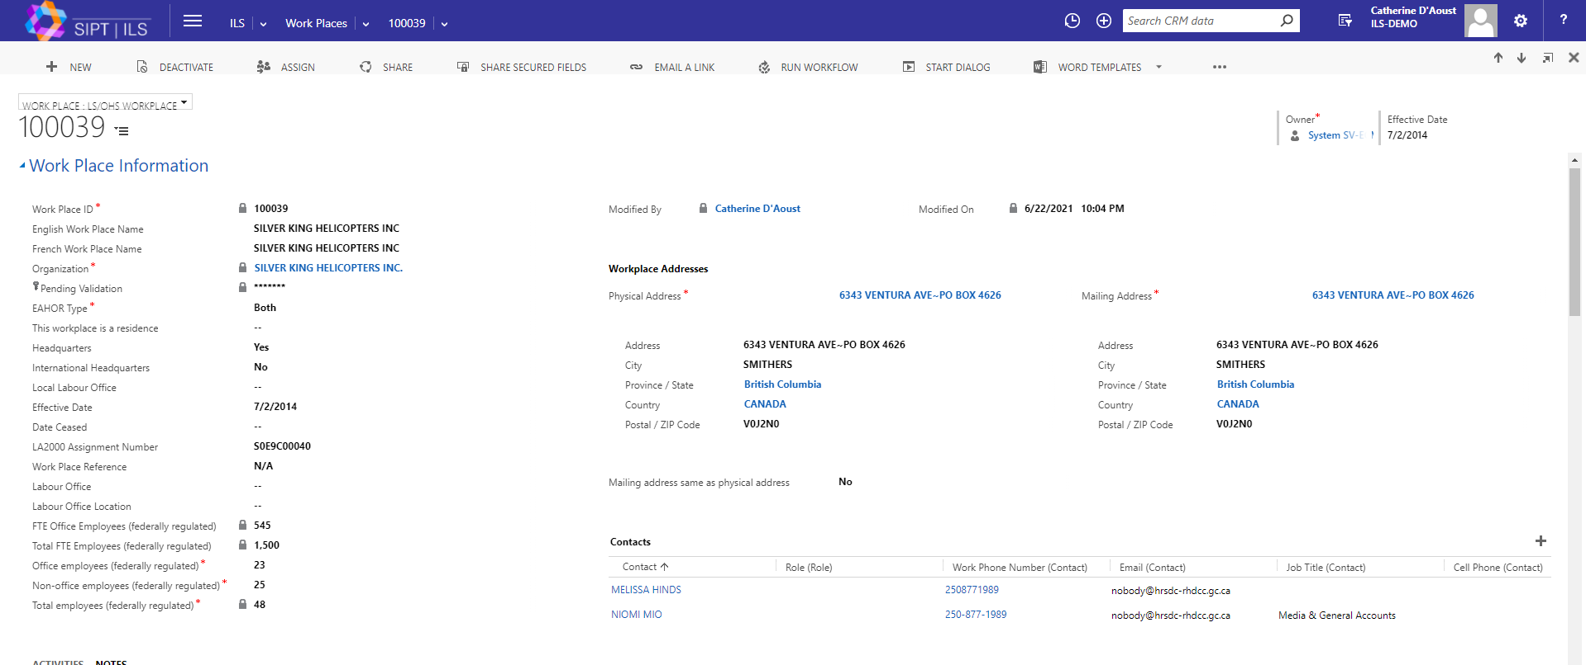
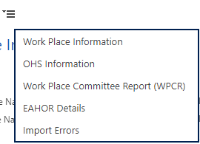
Work Place - Content
Once you access the content of a Work Place, you will see that the information is broken down in the same way as an Organization – that is to say into Section Tabs.
The Work Place Information section provides the primary information related to the work place itself (i.e the Work Place ID, the addresses, the number of employees etc.)
While their functions are the same as under Organizations, the Contacts, Jurisdictions, Permits /Exemptions/ Notifications and Activities titles fall under the Work Place Information section, rather than having sections of their own.

Slide 28
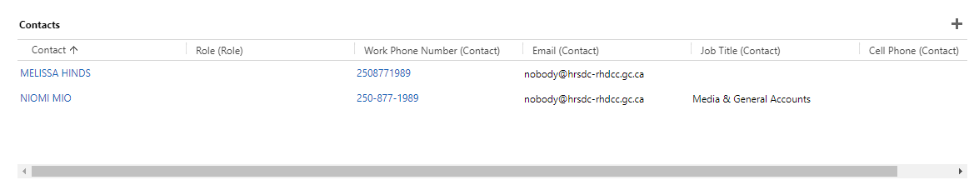
Work Place – Content (cont.)
Contacts displays the list of ILS Contact records associated to the Work Place. We will address the Contacts a little later in this module.
To add an additional Contact, simply use the Add Associated Contact record icon located at the top, right hand side of the list.

Slide 29
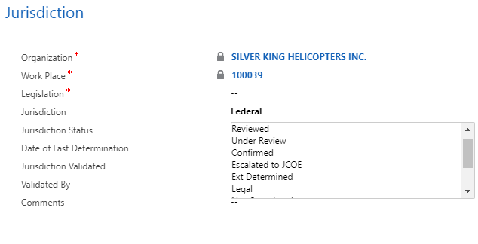
Work Place – Content (cont.)
The Jurisdiction at the Work Place area under the Work Place Information section provides an overview of all the jurisdictions associated with the current work place.
To add a jurisdiction record, simply use the Add Jurisdiction record icon.
The Jurisdiction can be adjusted at any time by accessing it and making the change in the Jurisdiction field.

Slide 30
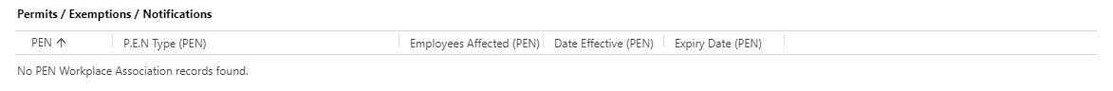
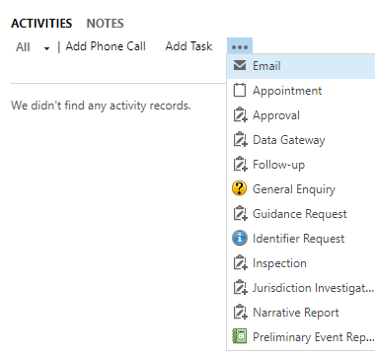

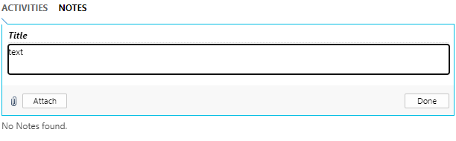
Work Place – Content (cont.)
Like Contacts and Jurisdictions, the Permits /Exemptions/ Notifications and Activities areas function in the same way as they do under Organizations.

Slide 31
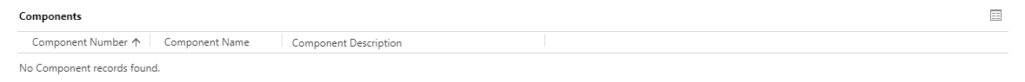
Work Place – Content (cont.)
The Components tab allows you to specify a particular area on a site. For example, a specific hangar at an airport.

Slide 32
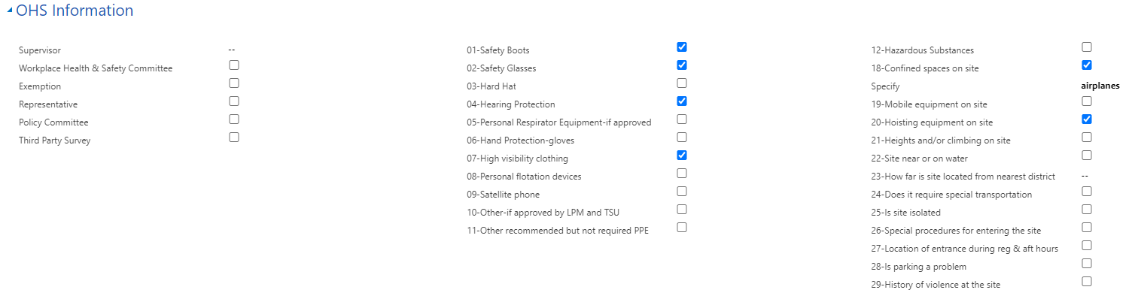
Work Place – Content (cont.)
The OHS (Occupational Health and Safety) Information section provides a check list of information that can be specified about the site.

Slide 33
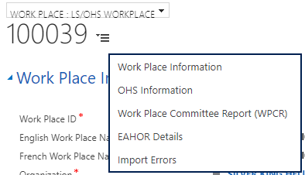
Work Place – Content (cont.)
The Work Place Committee Report (WPCR) and EAHOR Details sections are only available to specific users, and will be covered in more detail in Module 12 (OHS Reports).

Slide 34
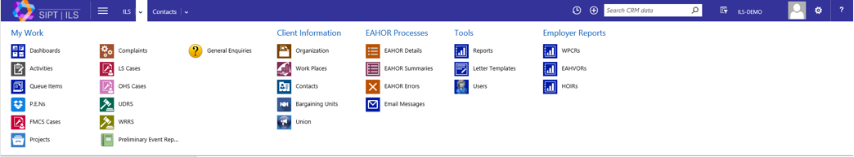
Contacts
Under the Client Information, there is a category called Contacts. This refers to specific persons that may be associated with a given record.
Lets select Contacts from the ILS Main Menu.

Slide 35
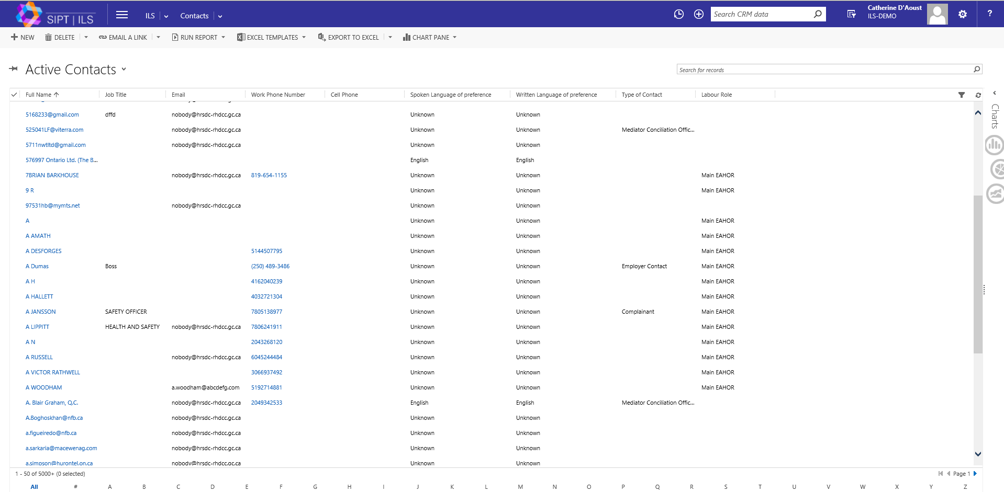
Contacts - Overview
The list that appears will display all Active Contacts.
As with the other Client Information categories, the list command toolbar that appears at the top is the same.

Slide 36
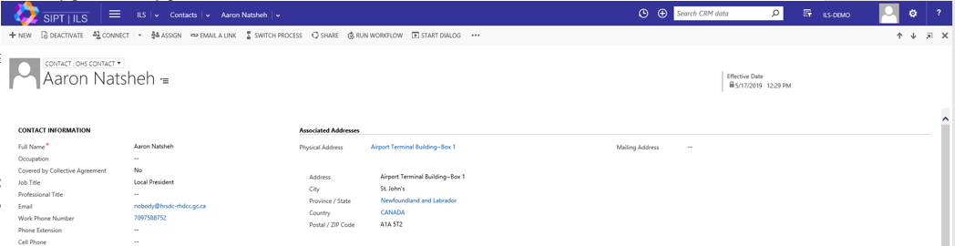

Contact - Content
Notice that the Contact category does not have tab sections. Content information is limited and can be accessed by scrolling down.

Slide 37
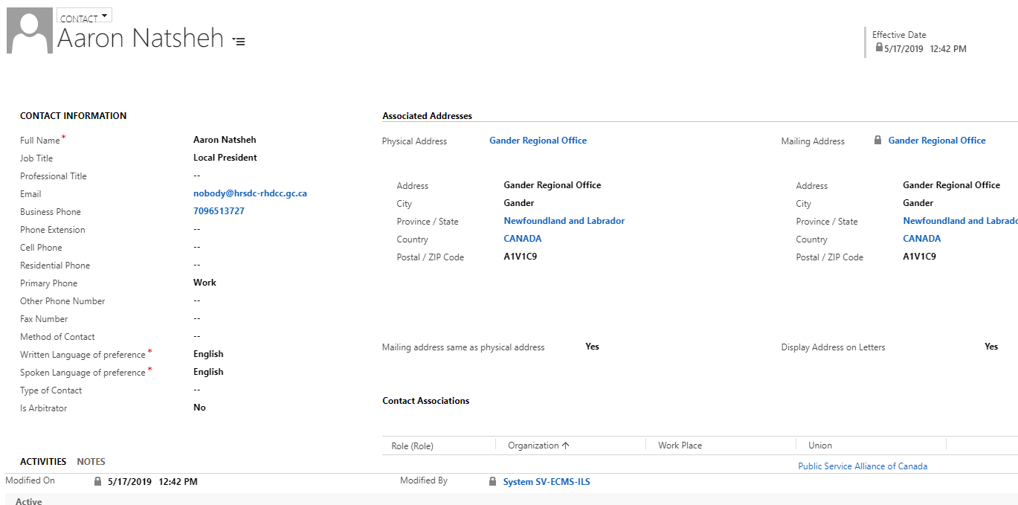
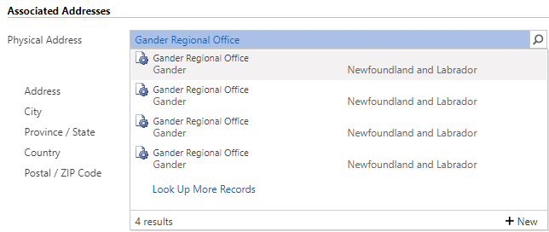
Contact – Content (cont.)
The Organization Information section provides the primary information about the organization itself. Details such as the name, ID number, Industry type, etc.
When you highlight one of the listed addresses under Associated Addresses, a Look Up option pops up allowing you to associate Client Information categories to each other. You can also select the New icon into a look up field and create a new entity.

Slide 38
Contact – Content (cont.)
If you select the plus icon located under the Associated Organization/Work Place section it will lead you to a look up field where you can add associated Active Work Places to the list (the same can be done under the Allowed Roles section).

Slide 39
ILS
Integrated Labour System
End of Module 2
Training Program

